Slide 1
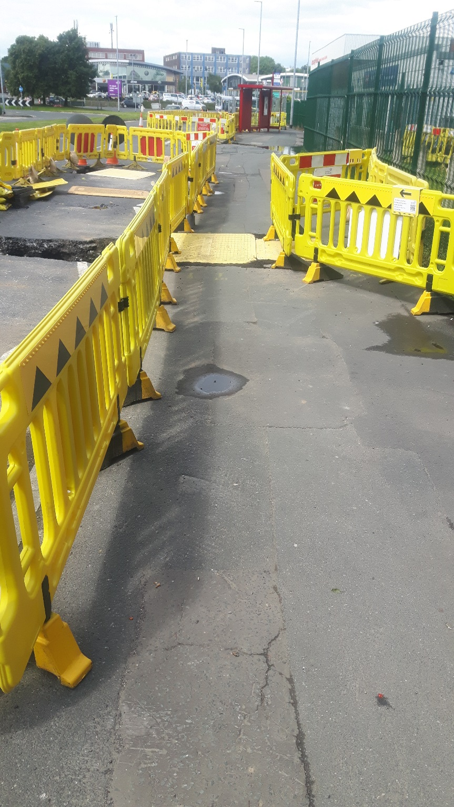


Tactile Barriers and StreetWorks App. for the blind and partially sighted
Ashley Whitfield

Slide 2
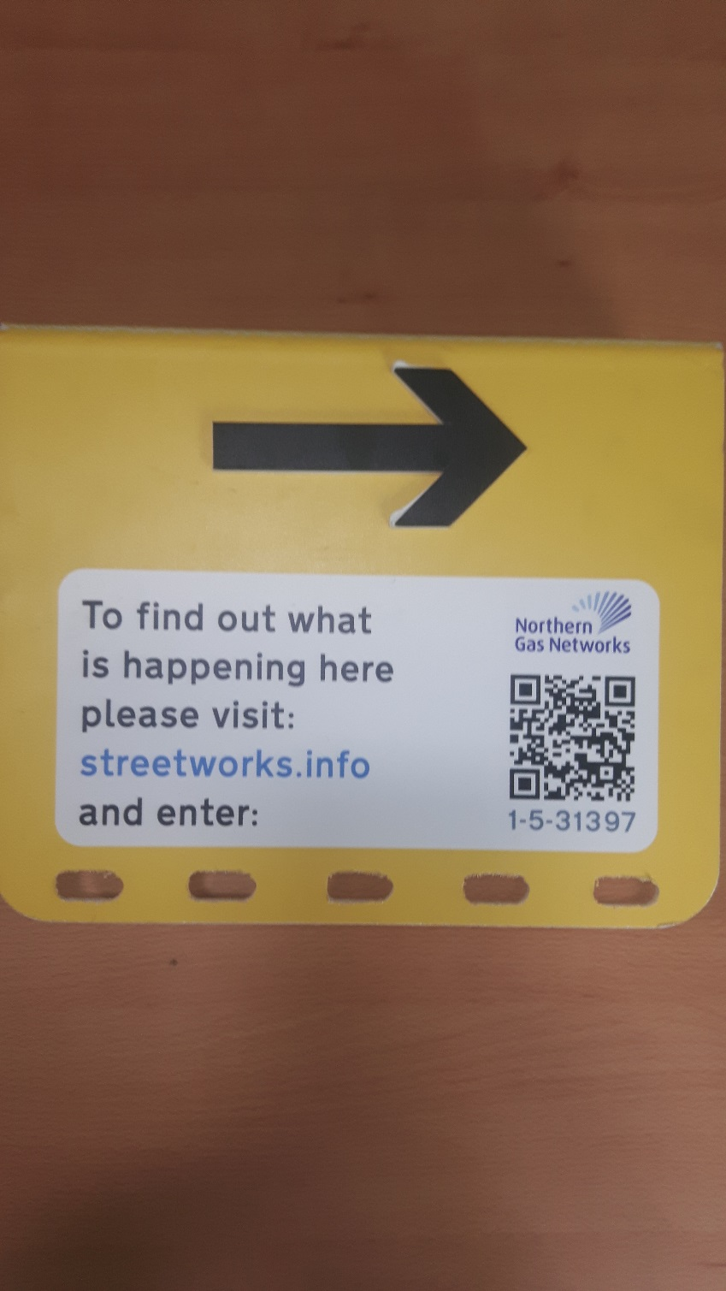
Street Works Info a system for signing and
guarding street works sites that communicates
extra information to pedestrians who are affected
by them. It provides blind and partially sighted
people with useful navigational information whilst
providing members of the general public with up
to date details about what is happening on site.
The system has two major components:
1) Physical changes to the barriers and additional
tactile direction signs which provide tactile and
visual navigation information.
2) A digital system with an app to register a site
description which is then delivered to pedestrians
when they approach the site.
For the system to provide accurate
information to users, both physical and
digital elements must be configured
correctly. This manual is a compliment
to not a replacement for ‘Safety at
Street Works and Road Works: A Code
of Practice’; known as “The Red Book”.

Slide 3
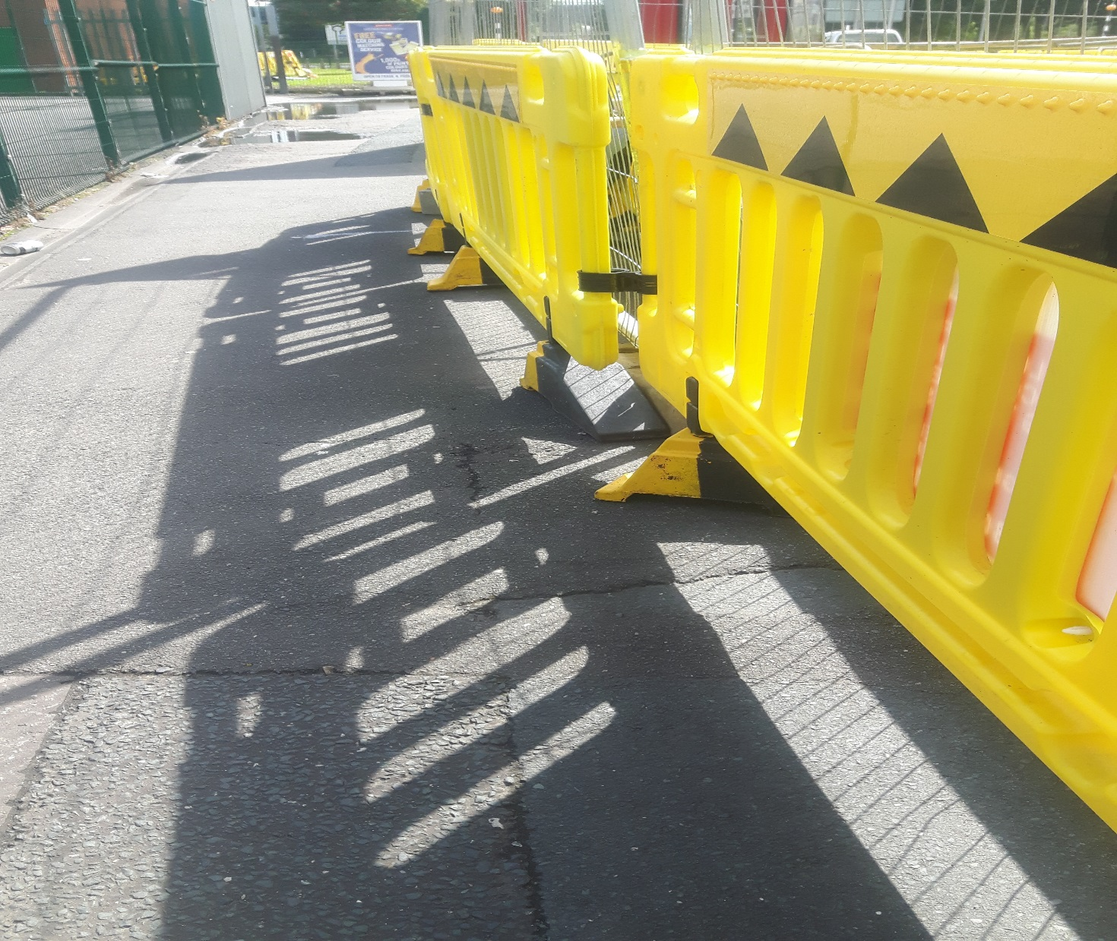
Barriers should always be deployed with the yellow and black triangles
(and tactile dots) where pedestrians would be expected and the red and
white rectangles on the side vehicles would be expected,
or on the side of the works.

Slide 4
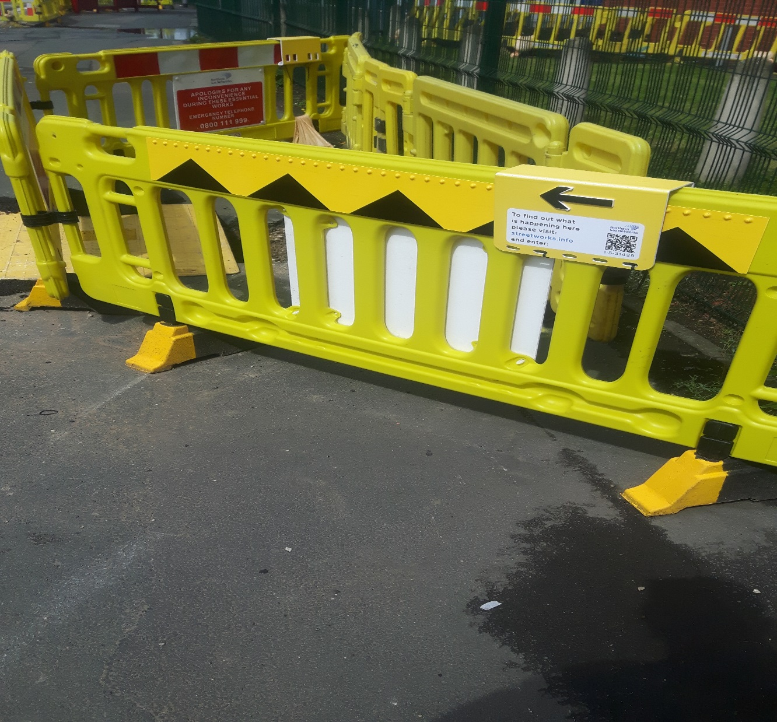
Each sign should be attached to the barrier with cable ties as shown:

Slide 5

Logging the site with the app
Search for:
StreetWorks.info Log on IOS or Android
Once the site has been set up it must be logged in the
‘StreetWorks.Info Log’ app which is available
in the iOS App Store and Android Google Play Store.

Slide 6
Log into the app using your e-mail address
and password.

Slide 7
You will be presented with a list of sites
owned by your account. If you have not set
up any sites this will be blank.
To
To add a new site, or move an existing one,
press ‘+ ADD SITE +’

Slide 8
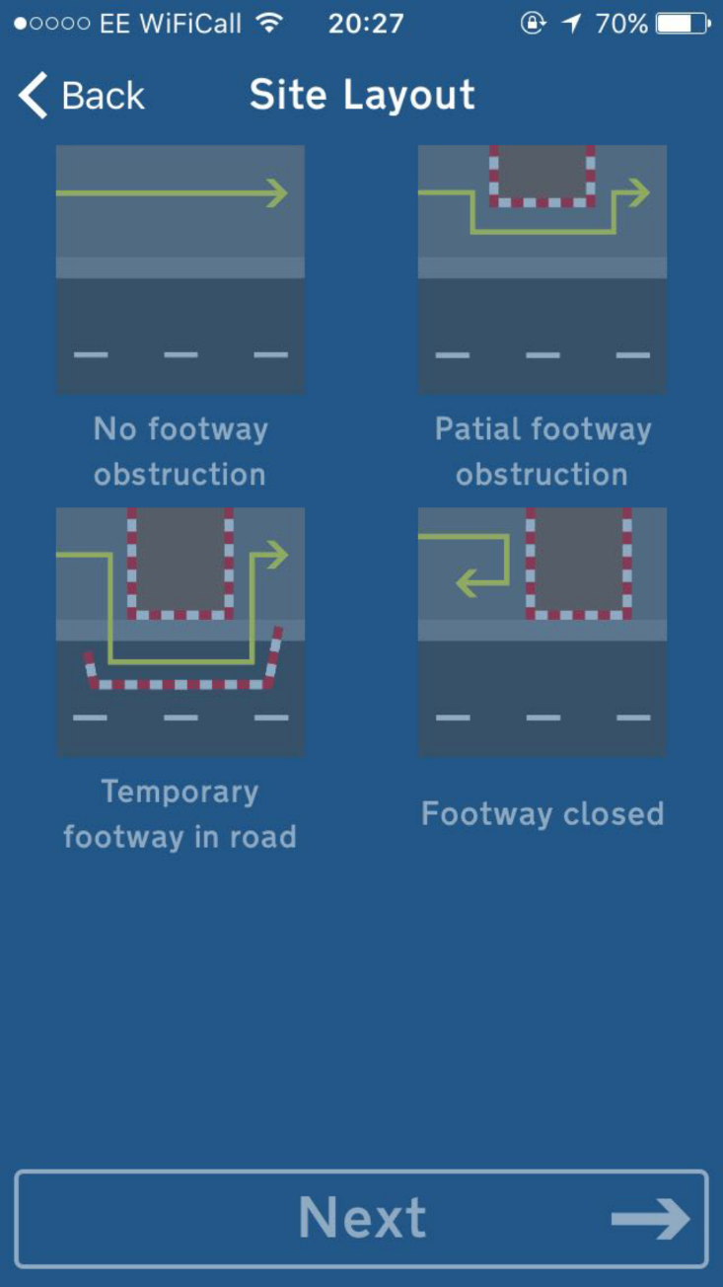
You will be asked to select the layout
of the site from four options. Select the
option that most closely describes the site
you have just set up.
Press ‘NEXT’ when you have selected the
appropriate layout.

Slide 9
If you have selected a layout other than
‘Footway Closed’ you will be asked to
‘Scan Right Code’. This is the QR code on
the yellow barrier-top sign with the right pointing
arrow.

Slide 10
The app will check to ensure that it can
detect the beacon in the sign before
proceeding to the next step. If the app can
not detect the beacon first make sure that
Bluetooth is switched on, on the phone.
Next check that the beacon is still present
in the sign and that it has battery and is
switched on.
Once the right arrow has successfully been
logged you will be asked to scan the left
arrow.

Slide 11
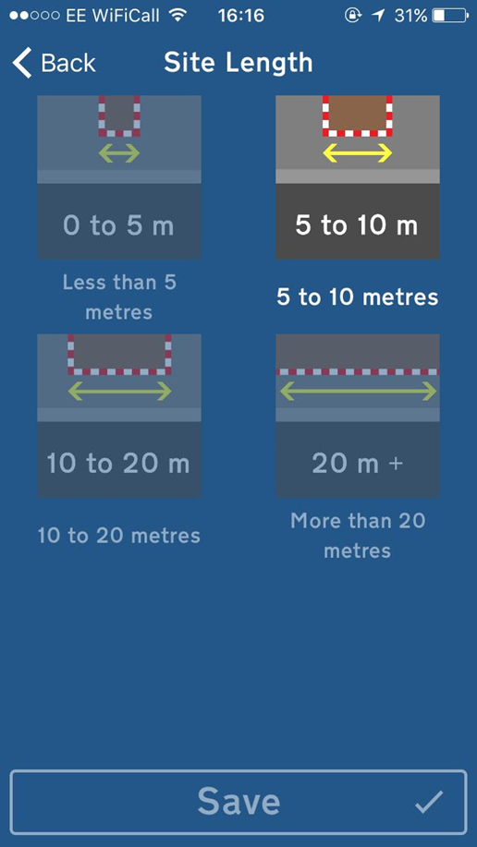
You will be asked to select the length
of the site from four options. Select the
option that most closely describes the site
you have just set up.
Press ‘NEXT’ when you have selected the
appropriate length.

Slide 12
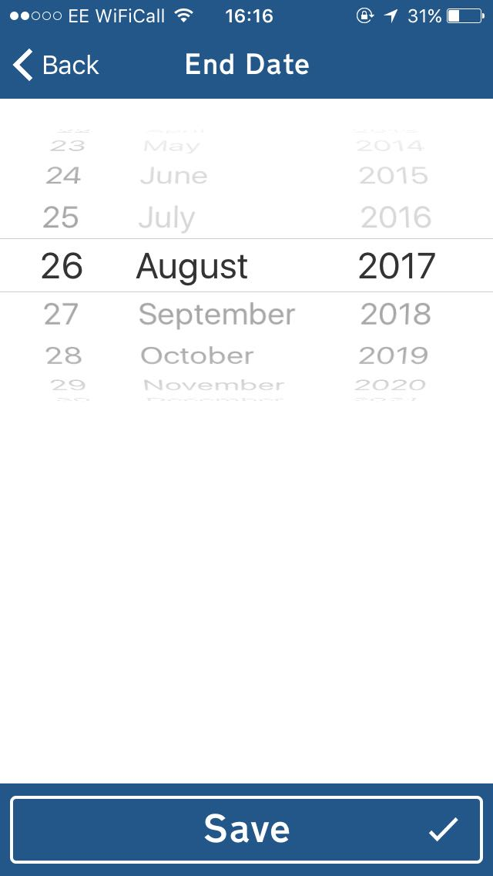
You will be asked to select end date for the
works. This should be the date you expect
the site to be clear of TM and back to
normal. You can open the app and amend
this date whenever you need to.
Press ‘NEXT’ when you have selected the
appropriate end date.

Slide 13
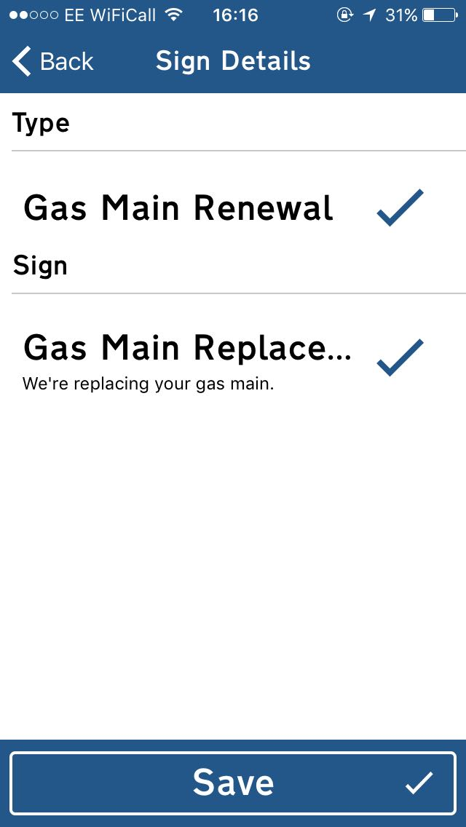
You will be asked to select the type of
work being undertaken. Depending on how
your organisation has set up the system
there may be only one or several types.
Selecting a type will reveal the information
sign options associated with that type.

Slide 14
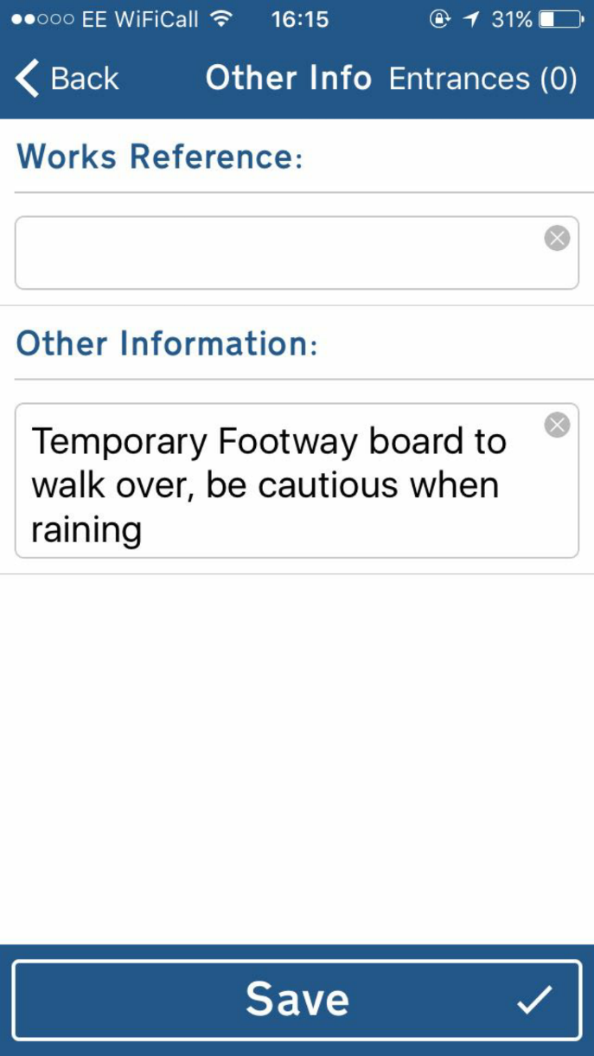
Select the appropriate information sign.
You can open the app and switch over this
sign whenever you need to.
Press ‘NEXT’ when you have selected the
appropriate information sign.

Slide 15
A screen will appear with space for Works
Reference and Notes. You may leave
both of these blank. You can use Works
Reference to keep track of the permit
associated with the job.
Use ‘Notes’ to mention any additional
impacts the site may make on disabled
people, other than the layout. This would
include actions like moving bus stops,
closing or moving controlled crossings,
moving the main entrances of major
buildings, etc.
From this screen you can also log any
entrances within the site (to maintain
access to properties for example).

Slide 16
The names of each entrance can be logged
in order from the right arrow sign to the
left.
Additional entrances can be added by
pressing ‘+ADD ENTRANCE+’ and existing
ones can be removed by pressing the red
cross to their right.
Sight Line will read out each entrance in
the order the user will approach them in
based on the side they have approached
from.

Slide 17
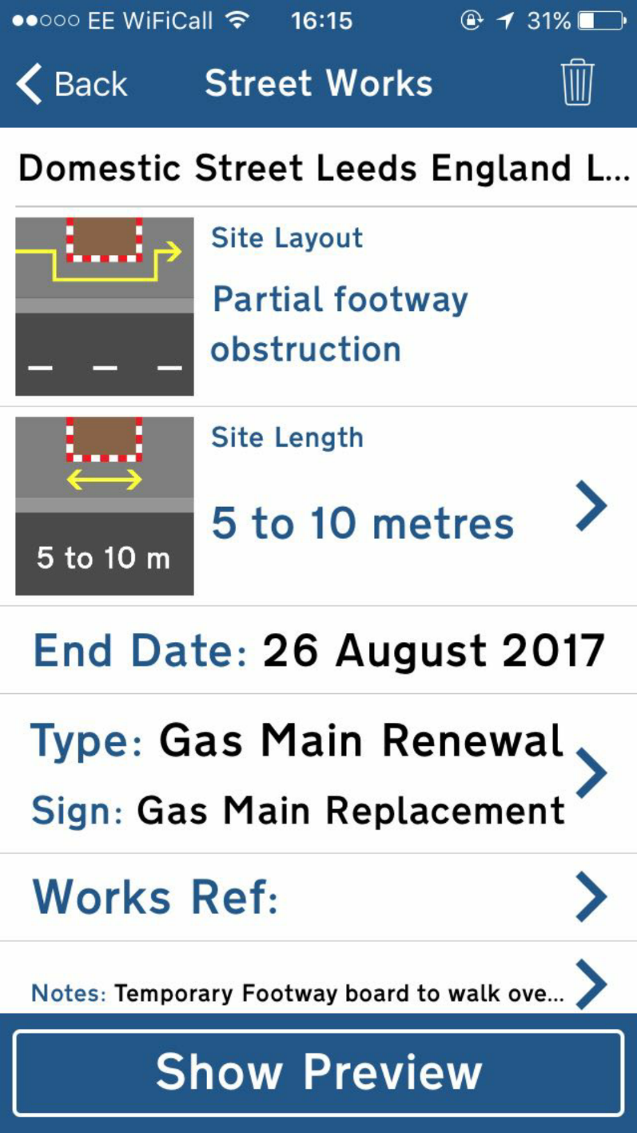
After pressing ‘NEXT’ on the ‘Other Info’
screen a screen will appear with a summary
of the information you have entered. Check
it is correct and if so press ‘SAVE’. This will
create the record of the site and make site
information to users of both StreetWorks.
info and Sight Line.

Slide 18
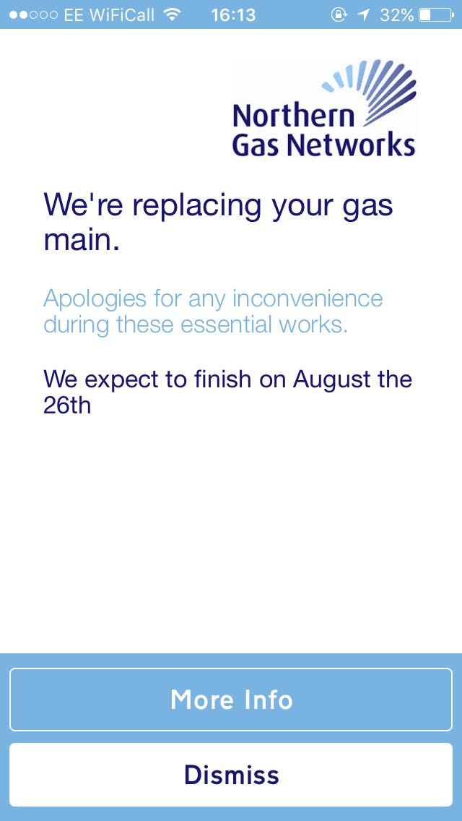
Once the site has been created the app will
show a preview of the information sign that
will be served to users of StreetWorks.info.

